Slide 1
Normal forms
Normal forms

Slide 2
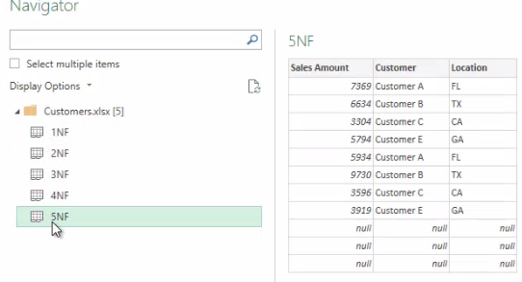
Normal forms
Note: This Lab uses the Customers.xlsx file located in the resources\Advanced Transformations folder
Load the Customers.xlsx file into the query editor. The workbook contains five examples of normal form violations.

Slide 3
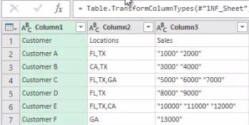
Normal forms
Edit the first table 1NF
Start with the Locations column by doing a Split Column with a comma as delimiter,
the split will keep both parts

Slide 4
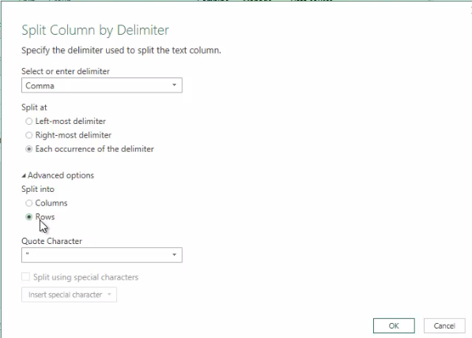
Normal forms
In the advanced options, you must choose Split by row instead of Split by column.
1
2
3

Slide 5
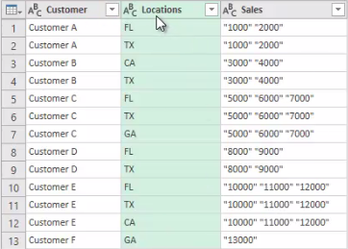
Normal forms
Check that the query has this form which is consistent with the first normal form

Slide 6
Normal forms
Spot the same operation to normalize the Sales column
Duplicate 1NF and rename Sales
Delete all columns except the Sales column
a 0-based index column to the Sales table , in this case use the Index Column functionality of the Add Column tab
Move Index column to first position
Go back to 1NF and add an index column in the same way
Select both queries 1NF and Sales , click Combine from the Home tab to apply the Merge functionality with the common column as Index , the join should be Inner

Slide 7
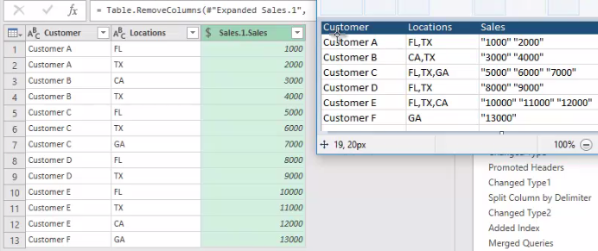
Normal forms
The fourth normal form is not respected
Delete table 1NF
Duplicate the Sales table and call the new table Customers
Keep the Customer column and delete the rest of the columns
Remove duplicates from the Customer column and add an index column

Slide 8
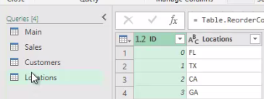
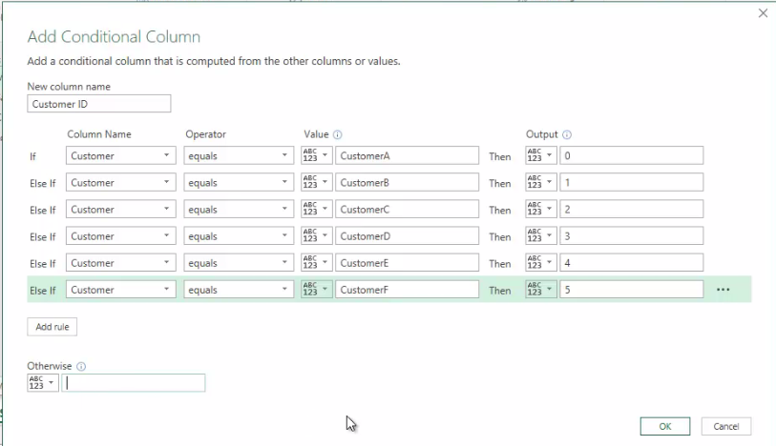
Normal forms
Repeat the same action to create a Locations query
Rename table 1NF to Sales add conditional column Customer ID

Slide 9
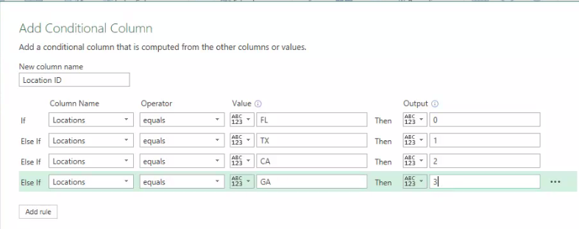
Normal forms
Repeat the same previous action adding Location ID

Slide 10
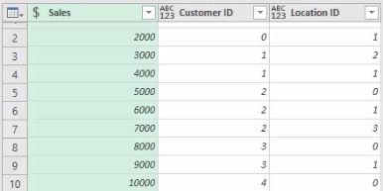
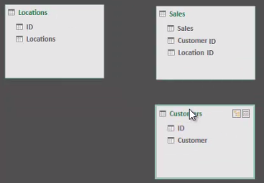
Normal forms
Check that the Sales table matches this shape
Visualize tables at the model space level

Slide 11
Thank you
Thank you

